Slide 1
CRIMIS
Group 2

Slide 2
Scenario
There is a gas leak in the chemistry lab
An informant reports incident:
The software is on the informants phone
The informants fills out the Incident Form

Slide 3
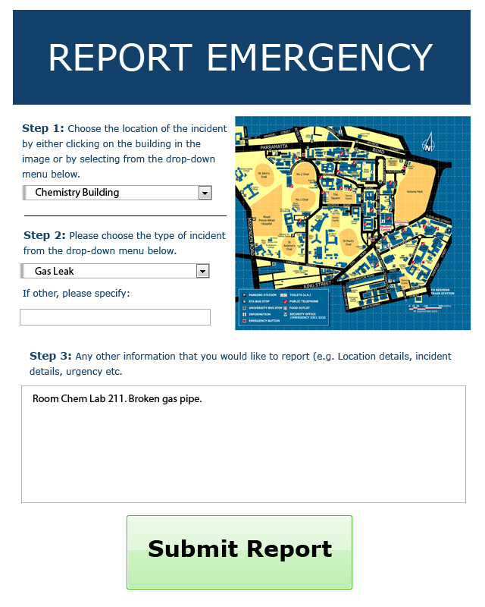
Incident Form

Slide 4
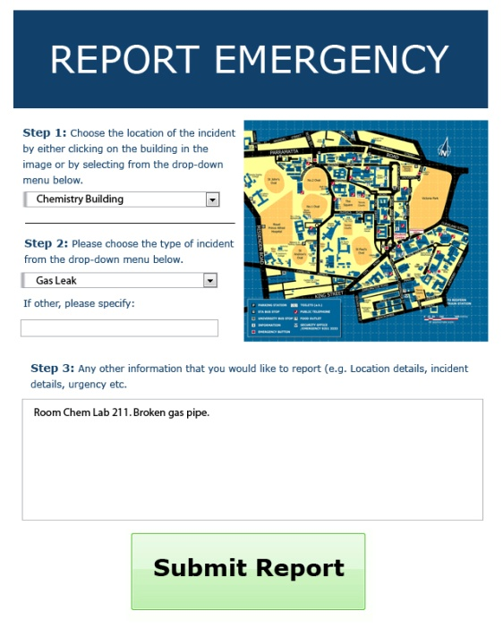
After the form is sent in
The System Creates an Incident Report
This a report of information the system has derived from the form sent in
INCIDENT REPORT
Perimeter : 20m
Transmit Radius : 100m
Time : 15:00
Location : Chemistry Building, Lab 211
Type : Gas Leak
Urgency Level : 6.5

Slide 5


Determining and Informing Authorities
System determines appropriate authorities
Authorities are notified of incident
INCIDENT REPORT
RULE-SET

Slide 6
Sending Notifications to Community Members
System generates guidance according to rule-set
System sends out notification + guidance according to transmit radius determined
INCIDENT REPORT
RULE-SET

Slide 7
Authority Override

Slide 8
Manager Duties

